Slide 1
SkinScan AI
AI & HEALTH CARE
Sridhar
Adithya
Vagdevi
Pranathi

Slide 2
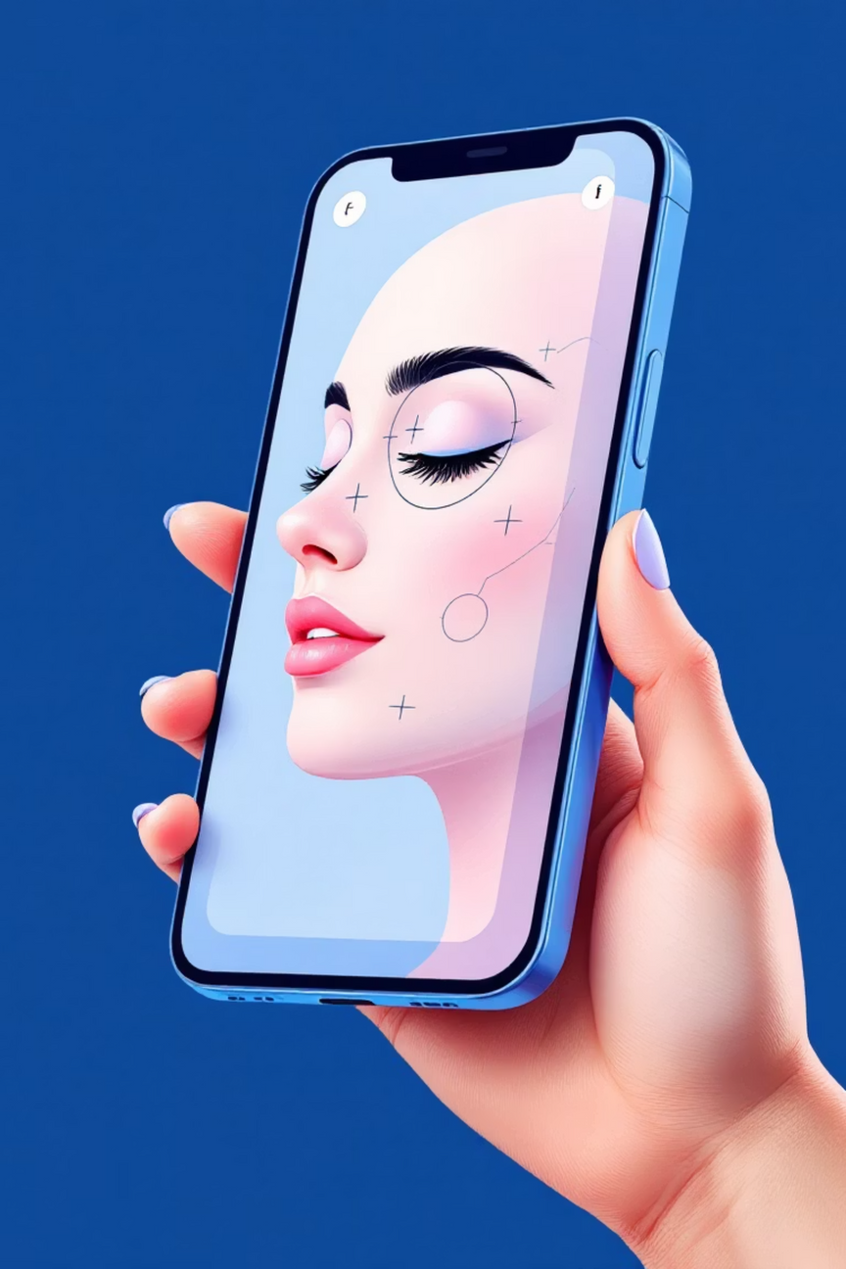
SkinScan AI
AI-Powered Skin Condition Diagnosis
"An AI-powered app that scans skin images and categorises conditions into cancer, skin disease, or normal, guiding users with the right next steps."
Notes:
1

Slide 3

Market Need & Opportunity
1/3
2B+
75%
Global Impact
Market Size
Growth Rate
People suffer from skin issues annually worldwide
People worldwide live with skin diseases according to WHO
Annual increase in telemedicine adoption for healthcare
The convergence of AI healthcare solutions and increasing demand for accessible medical diagnosis creates an unprecedented market opportunity.
Notes:
2

Slide 4



Real-World Evidence
World Health Organization
American Cancer Society
"Skin diseases are among the most common human health problems, affecting nearly 2 billion people worldwide. Early intervention through accessible diagnosis tools can significantly improve patient outcomes."
"Skin cancer is the most common type of cancer globally, with early detection improving survival rates by over 90%. Technology-enabled screening can save countless lives."
These statistics underscore the urgent need for accessible, AI-powered skin condition diagnosis solutions that can bridge healthcare gaps globally.
Notes:
3

Slide 5




Our Solution: Instant AI Diagnosis
Scan Image
Capture skin condition with smartphone camera
AI Analysis
Advanced machine learning processes the image
Classification & Guidance
Receive diagnosis and personalised next steps
Notes:
4

Slide 6
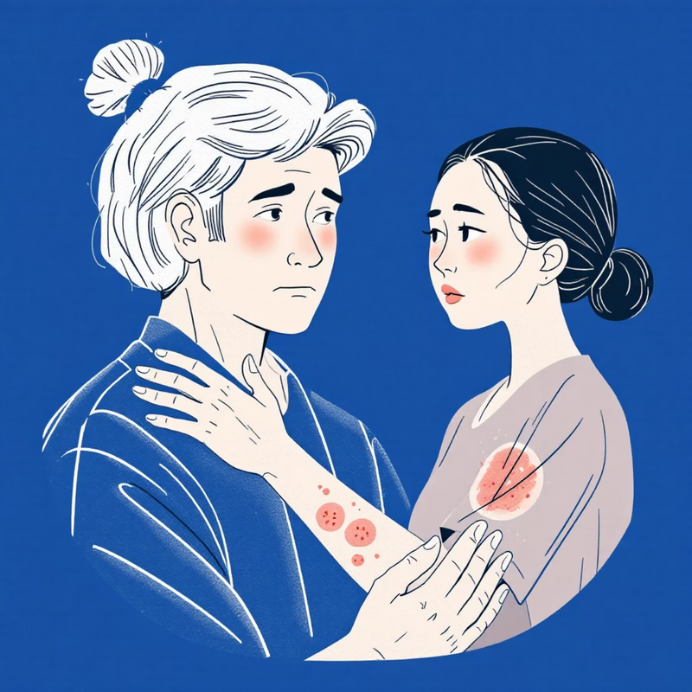
The Critical Healthcare Gap
Skin conditions affect billions globally
Patients face delayed diagnosis due to multiple barriers that prevent timely care and early intervention.
Limited access to dermatologists
High consultation costs
Expensive private healthcare and insurance gaps
Long waiting periods and specialist shortages
Lack of immediate guidance
Uncertainty about when to seek professional help
Critical Timing: Early detection of conditions like skin cancer is critical and saves lives.
Notes:
5

Slide 7

How It Works: Three Pathways
Cancer Detection
Skin Disease Identification
Normal Skin Assessment
High Priority: Immediate specialist referral with nearest dermatologist recommendations and appointment booking assistance.
Medium Priority: Predicts suitable ointments and medications, locates nearby pharmacies with availability checker.
Low Priority: Provides comprehensive home-care tips, prevention strategies, and skin health maintenance guidance.
Notes:
6

Slide 8






Key Features & Capabilities
AI Skin Scan
Doctor Recommendations
Advanced image recognition with 95% accuracy rate using convolutional neural networks trained on medical datasets.
Immediate referrals for serious cases with verified specialist directory and real-time availability.
Medicine Suggestions
Maps Integration
Evidence-based ointment and medication recommendations with dosage information and contraindication alerts.
Precise location services to find nearby doctors, pharmacies, and medical facilities with navigation support.
Simple Care Tips
Secure Medical Data
Practical, actionable advice for minor conditions with step-by-step home treatment protocols.
HIPAA-compliant patient privacy with end-to-end encryption and secure cloud storage infrastructure.
Notes:
7

Slide 9





Technology Stack
Backend
AI Engine
Database
Python with FastAPI/Django for robust API architecture
CNN, TensorFlow, and PyTorch for machine learning models
Firebase and AWS for scalable cloud infrastructure
APIs
Google Maps Platform for location-based services
Security First: HIPAA-compliant architecture ensuring patient data protection at every layer.
Notes:
8

Slide 10





Impact & Benefits
Instant Diagnosis
Cost Reduction
Early Detection
Immediate AI assessment eliminating waiting times and reducing anxiety for patients seeking medical guidance.
Significantly reduces unnecessary hospital visits and consultation fees through accurate preliminary screening.
Improves treatment outcomes for serious conditions through timely identification and specialist referrals.
Rural Accessibility
Patient Empowerment
Provides quality healthcare guidance in underserved areas where specialist access is limited or unavailable.
Gives users knowledge, confidence, and clear guidance for informed healthcare decision-making.
Notes:
9

Slide 11

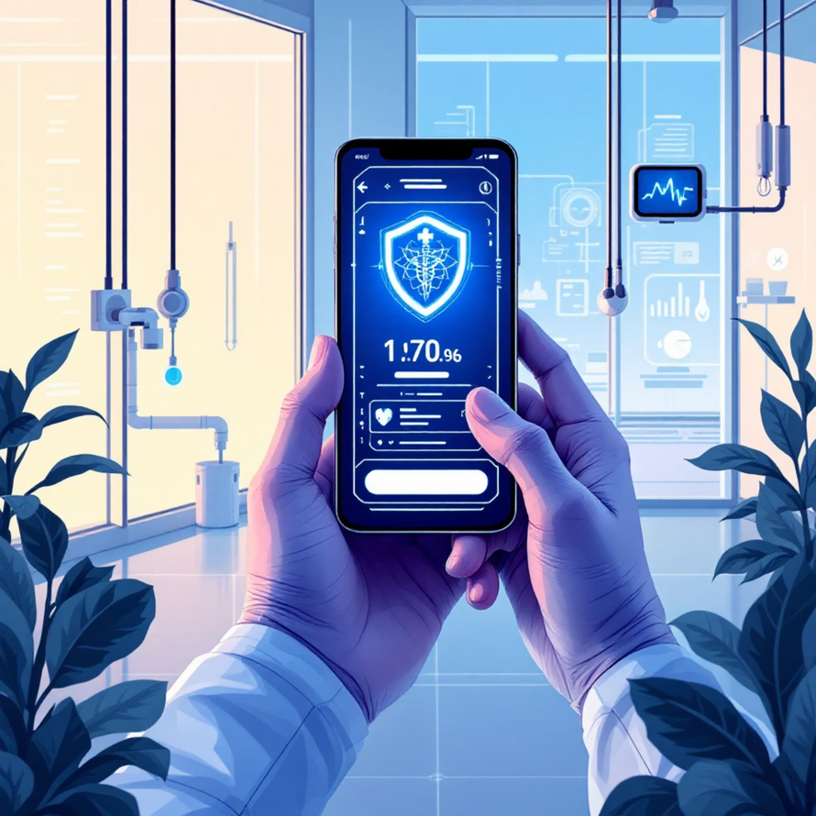
Roadmap & Future Scope
Short-term (6 months)
Long-term (24+ months)
AI model prototype development and comprehensive API architecture planning with initial dataset training.
Global market expansion, advanced AI capabilities integration, and strategic partnerships with major healthcare providers.
1
2
3
Mid-term (12 months)
Beta app launch with limited user testing, initial healthcare partnerships, and regulatory compliance validation.
Next Steps
Secure Series A funding for development acceleration
Partner with medical institutions for dataset enhancement
Begin regulatory approval processes in key markets
Notes:
10

